Slide 1
Sensitivity analysis
2023. 12. 06
SMEET LAB

Slide 2
Sensitivity analysis
Why Select a variable
DNN may not need to choose input variables. Because the coefficients of unnecessary variables will converge to zero. However, selecting many variables to make the model increases the computational cost of estimation
So, We need to find sensitivity input variable for reducing computing load

Slide 3
Sensitivity analysis
Variance Based analysis
As also known Sobol’s method
Using Decomposition of Variance
Can measure sensitivity across the whole input space

Slide 4
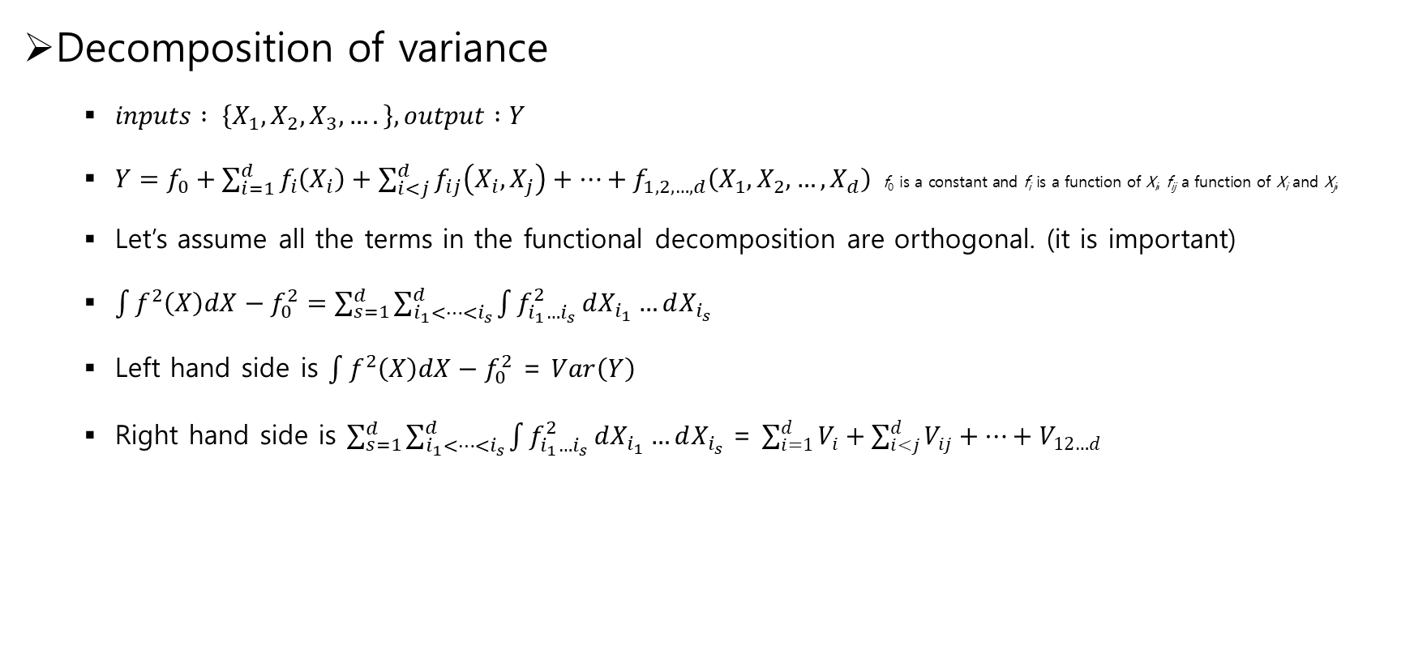
Sensitivity analysis
Decomposition of variance
$inputs : \left\{X_{1},X_{2},X_{3},….\right\}, output :Y$
$Y=f_{0}+\sum_{i=1}^{d}{f_{i}\left(X_{i}\right)}+\sum_{i<j}^{d}{f_{ij}\left(X_{i},X_{j}\right)}+⋯+f_{1,2,…,d}\left(X_{1},X_{2},…,X_{d}\right)$ $\text{f}\text{0} \text{is} \text{a} \text{constant} \text{and} \text{f}\text{i} \text{is} \text{a} \text{function} \text{of} \text{X}\text{i}\text{, }\text{f}\text{ij} \text{a} \text{function} \text{of} \text{X}\text{i} \text{and} \text{X}\text{j}\text{,}$
Let’s assume all the terms in the functional decomposition are orthogonal. (it is important)
$\int{f^{2}\left(X\right)dX}−f_{0}^{2}=\sum_{s=1}^{d}{\sum_{i_{1}<…<i_{s}}^{d}{\int{f_{i_{1}…i_{s}}^{2}}}}dX_{i_{1}}…dX_{i_{s}}$
Left hand side is $\int{f^{2}\left(X\right)dX}−f_{0}^{2}$ = $Var\left(Y\right)$
Right hand side is $\sum_{s=1}^{d}{\sum_{i_{1}<…<i_{s}}^{d}{\int{f_{i_{1}…i_{s}}^{2}}}}dX_{i_{1}}…dX_{i_{s}}$ = $\sum_{i=1}^{d}{V_{i}}+\sum_{i<j}^{d}{V_{ij}}+⋯+V_{12…d}$

Slide 5
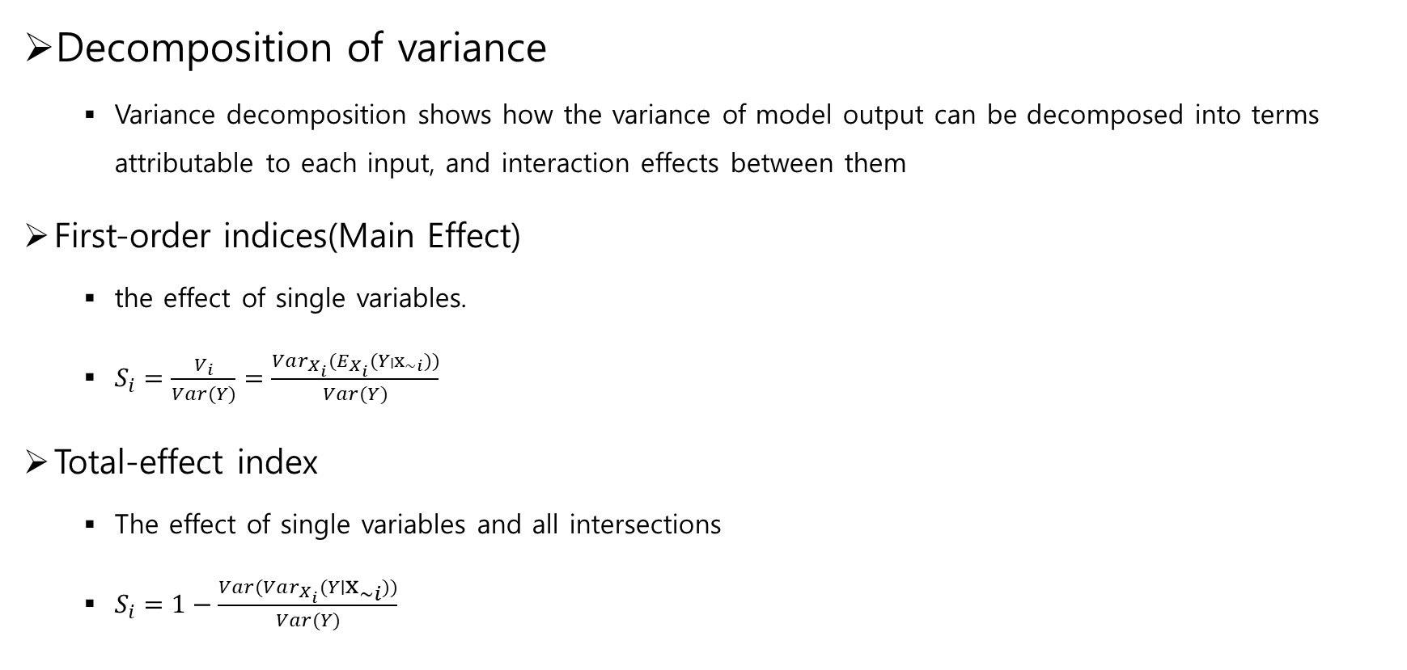
Sensitivity analysis
Decomposition of variance
Variance decomposition shows how the variance of model output can be decomposed into terms attributable to each input, and interaction effects between them
First-order indices(Main Effect)
the effect of single variables.
$S_{i}=\frac{V_{i}}{Var(Y)}=\frac{Var_{X_{i}}(E_{X_{i}}(Y∣x_{\sim i}))}{Var(Y)}$
Total-effect index
The effect of single variables and all intersections
$S_{i}=1−\frac{Var(Var_{X_{i}}(Y∣x_{\sim i}))}{Var(Y)}$

Slide 6

Sensitivity analysis
Example of Calculate $Var_{X_{i}}(E_{X_{i}}(Y∣x_{\sim i}))$
When X₁ is 1, the mean of the corresponding Y values, 11.33
X₁ | X₂ | X₃ | Y
1 | 2 | 3 | 10
1 | 3 | 1 | 11
1 | 4 | 5 | 13
2 | 2 | 2 | 15
2 | 3 | 1 | 14
2 | 1 | 4 | 16
… | … | … | …

Slide 7

Sensitivity analysis
Example of Calculate $Var_{X_{i}}(E_{X_{i}}(Y∣x_{\sim i}))$
When X₁ is 2, the mean of the corresponding Y values, 11.33
X₁ | X₂ | X₃ | Y
1 | 2 | 3 | 10
1 | 3 | 1 | 11
1 | 4 | 5 | 13
2 | 2 | 2 | 15
2 | 3 | 1 | 14
2 | 1 | 4 | 16
… | … | … | …

Slide 8

Sensitivity analysis
Example of Calculate $Var_{X_{i}}(E_{X_{i}}(Y∣x_{\sim i}))$
Means of X₁

Slide 9
Sensitivity analysis
Select Variable
Wheel speed, acc(x,y,z), steer, torque()

Slide 10
Q&A

Slide 11
THANK YOU!

